Slide 1
FORMS & TEXT FIELDS
Computing – Faculty of Business, Law and Digital
martin.reid@solent.ac.uk

Slide 2
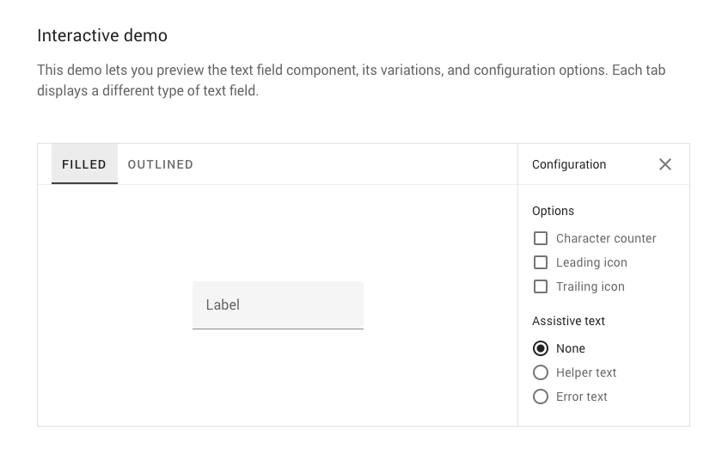
MATERIAL DESIGN, 2020. Material Design [viewed 15 November 2020]. Available from: https://material.io/components/text-fields

Slide 3
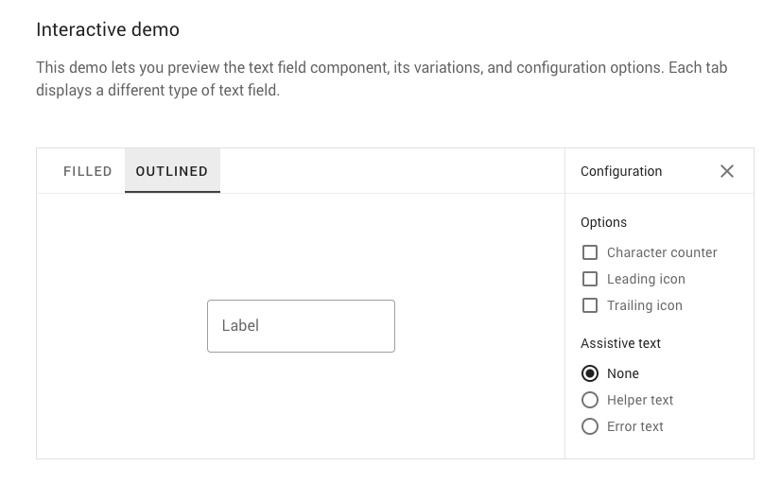
MATERIAL DESIGN, 2020. Material Design [viewed 15 November 2020]. Available from: https://material.io/components/text-fields

Slide 4
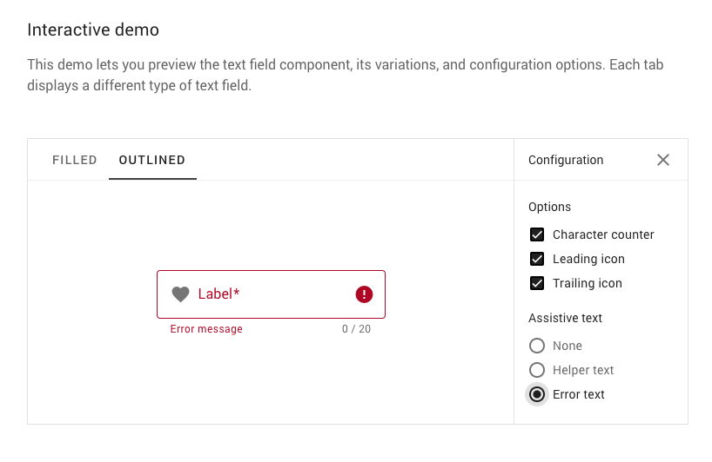
MATERIAL DESIGN, 2020. Material Design [viewed 15 November 2020]. Available from: https://material.io/components/text-fields

Slide 5
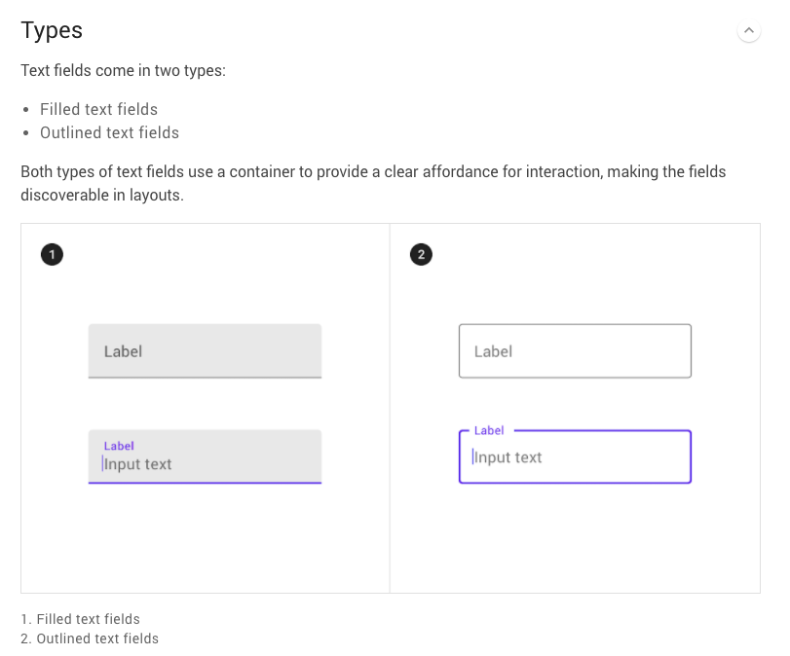
MATERIAL DESIGN, 2020. Material Design [viewed 15 November 2020]. Available from: https://material.io/components/text-fields

Slide 6
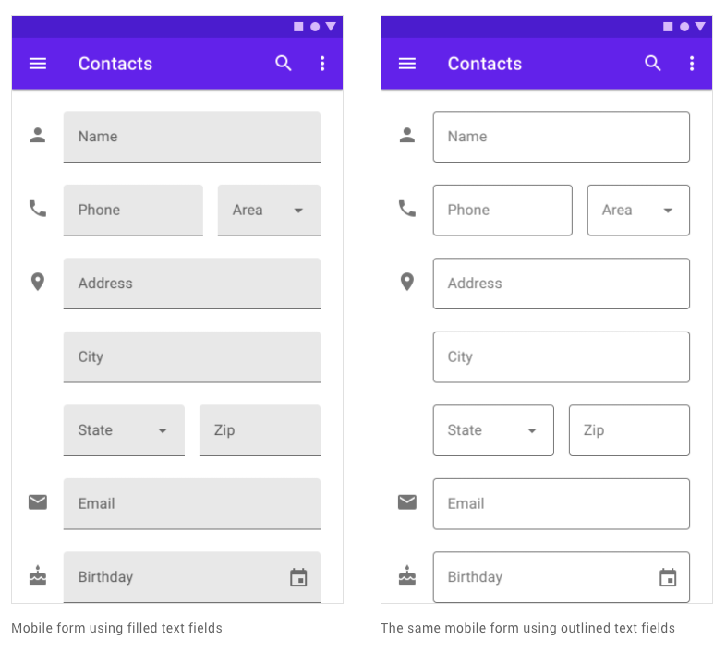
MATERIAL DESIGN, 2020. Material Design [viewed 15 November 2020]. Available from: https://material.io/components/text-fields

Slide 7
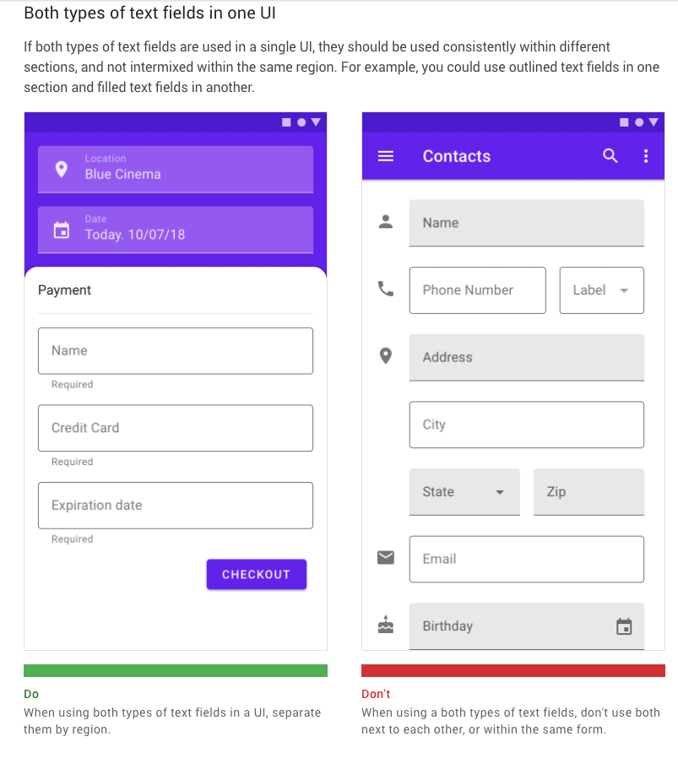
MATERIAL DESIGN, 2020. Material Design [viewed 15 November 2020]. Available from: https://material.io/components/text-fields

Slide 8
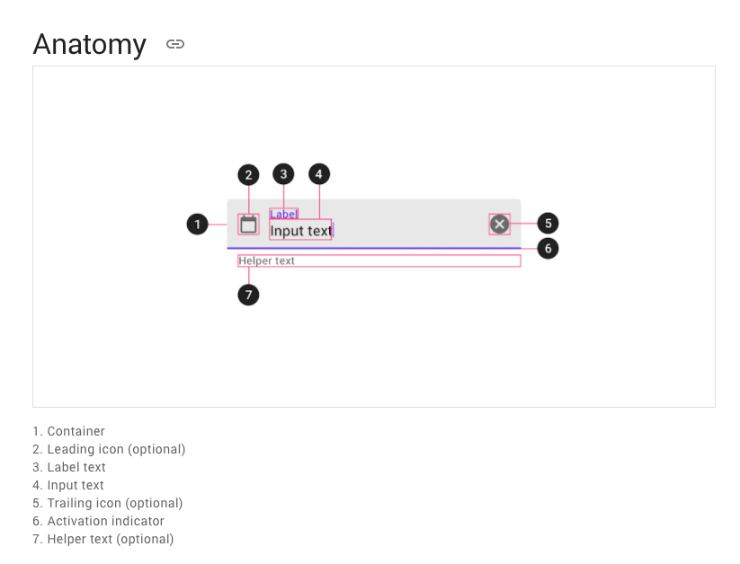
MATERIAL DESIGN, 2020. Material Design [viewed 15 November 2020]. Available from: https://material.io/components/text-fields

Slide 9
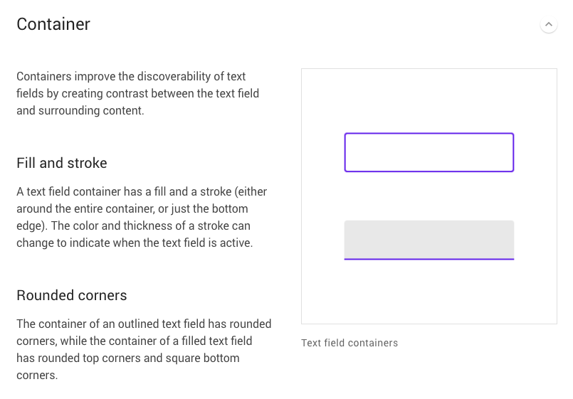
MATERIAL DESIGN, 2020. Material Design [viewed 15 November 2020]. Available from: https://material.io/components/text-fields

Slide 10
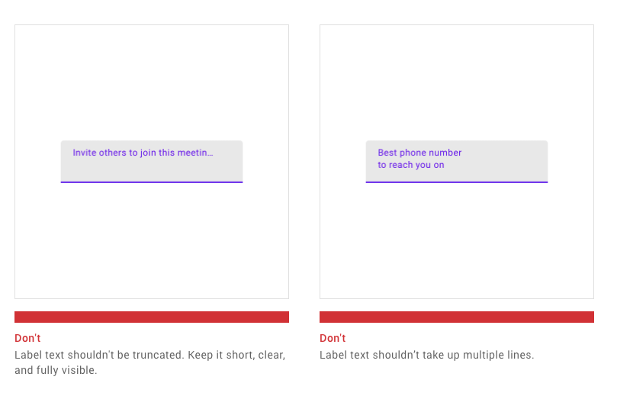
MATERIAL DESIGN, 2020. Material Design [viewed 15 November 2020]. Available from: https://material.io/components/text-fields

Slide 11
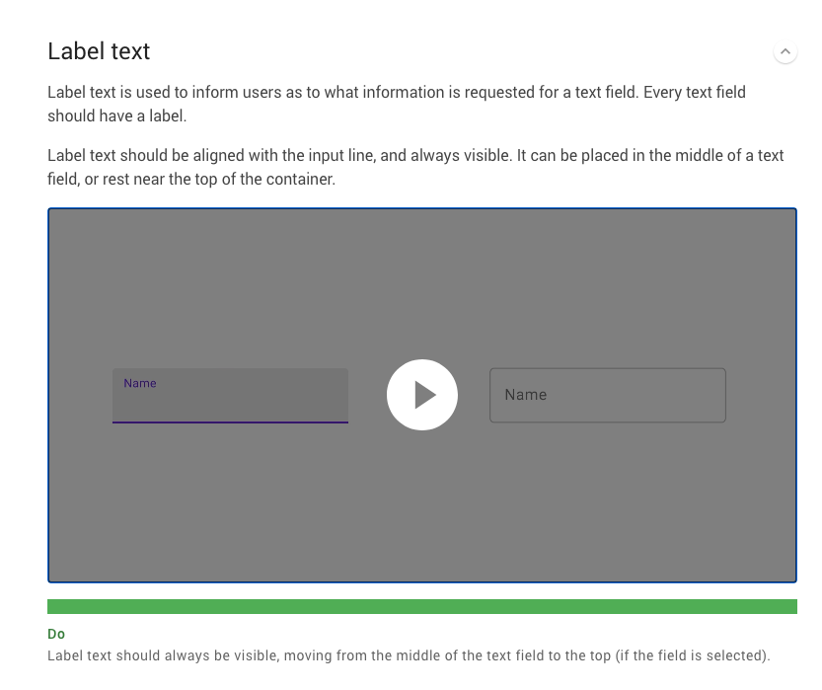
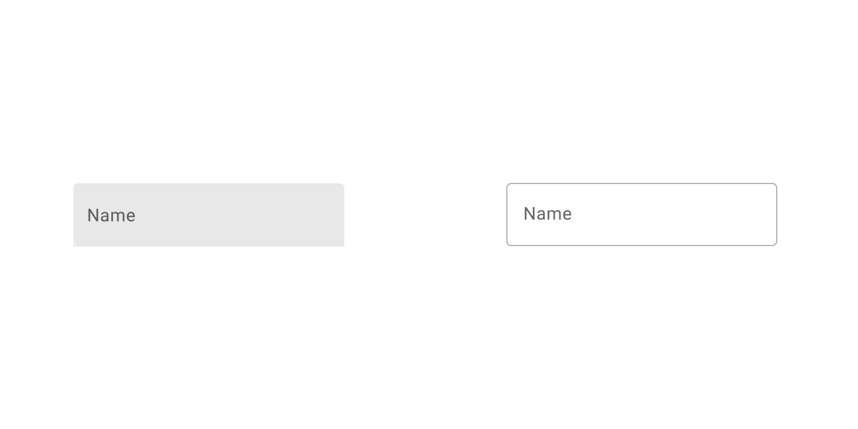
MATERIAL DESIGN, 2020. Material Design [viewed 15 November 2020]. Available from: https://material.io/components/text-fields

Slide 12
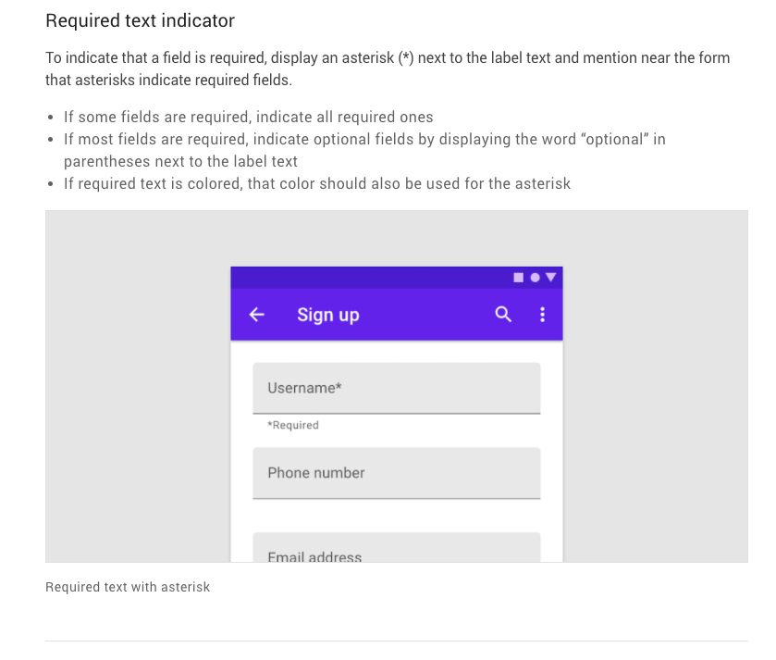
MATERIAL DESIGN, 2020. Material Design [viewed 15 November 2020]. Available from: https://material.io/components/text-fields

Slide 13
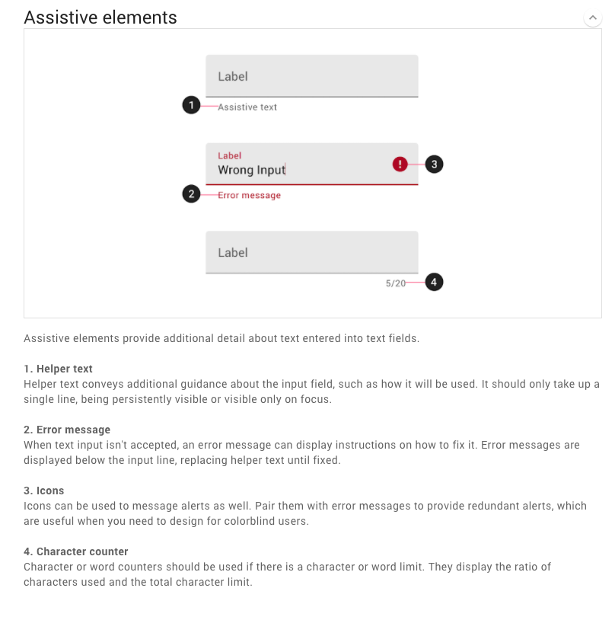
MATERIAL DESIGN, 2020. Material Design [viewed 15 November 2020]. Available from: https://material.io/components/text-fields

Slide 14
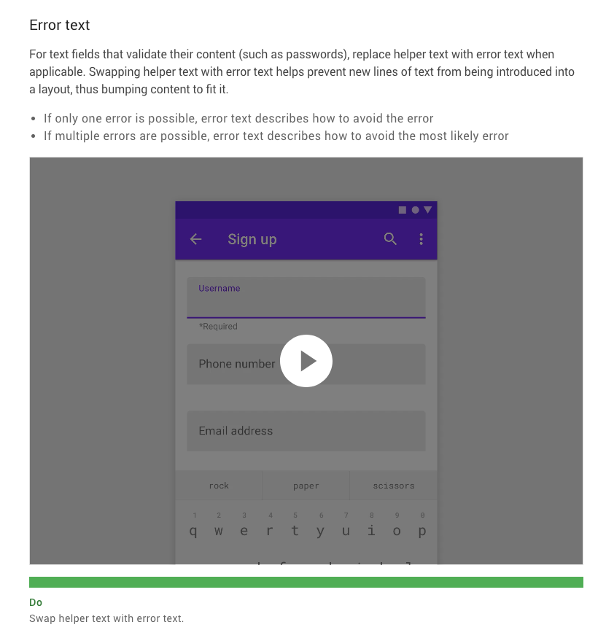
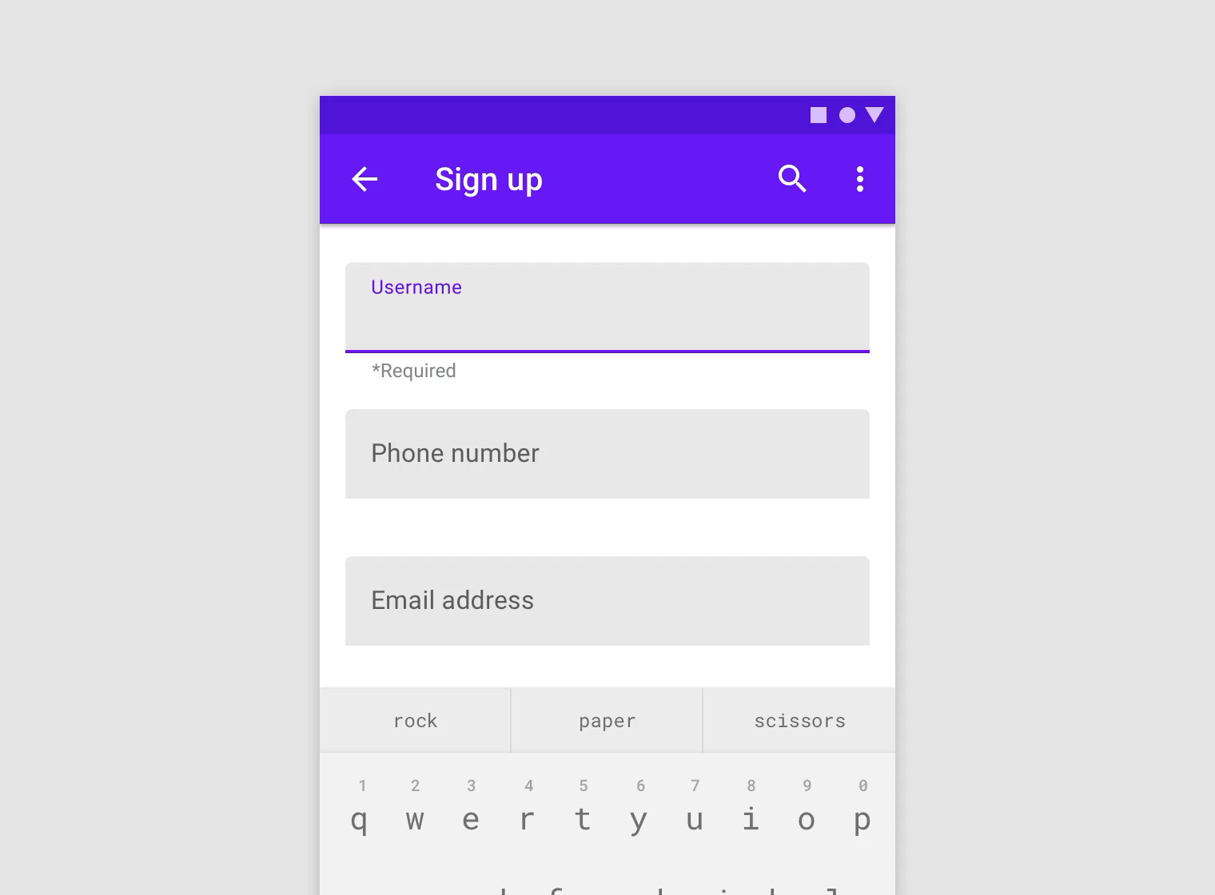
MATERIAL DESIGN, 2020. Material Design [viewed 15 November 2020]. Available from: https://material.io/components/text-fields

Slide 15
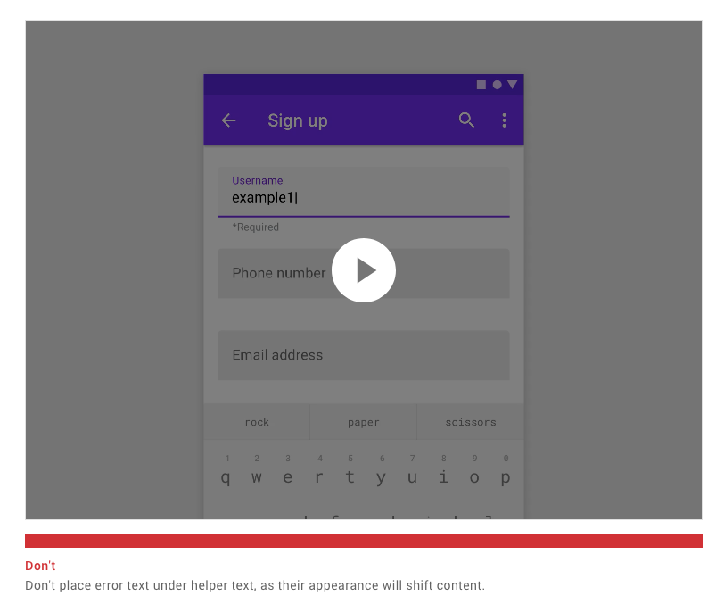
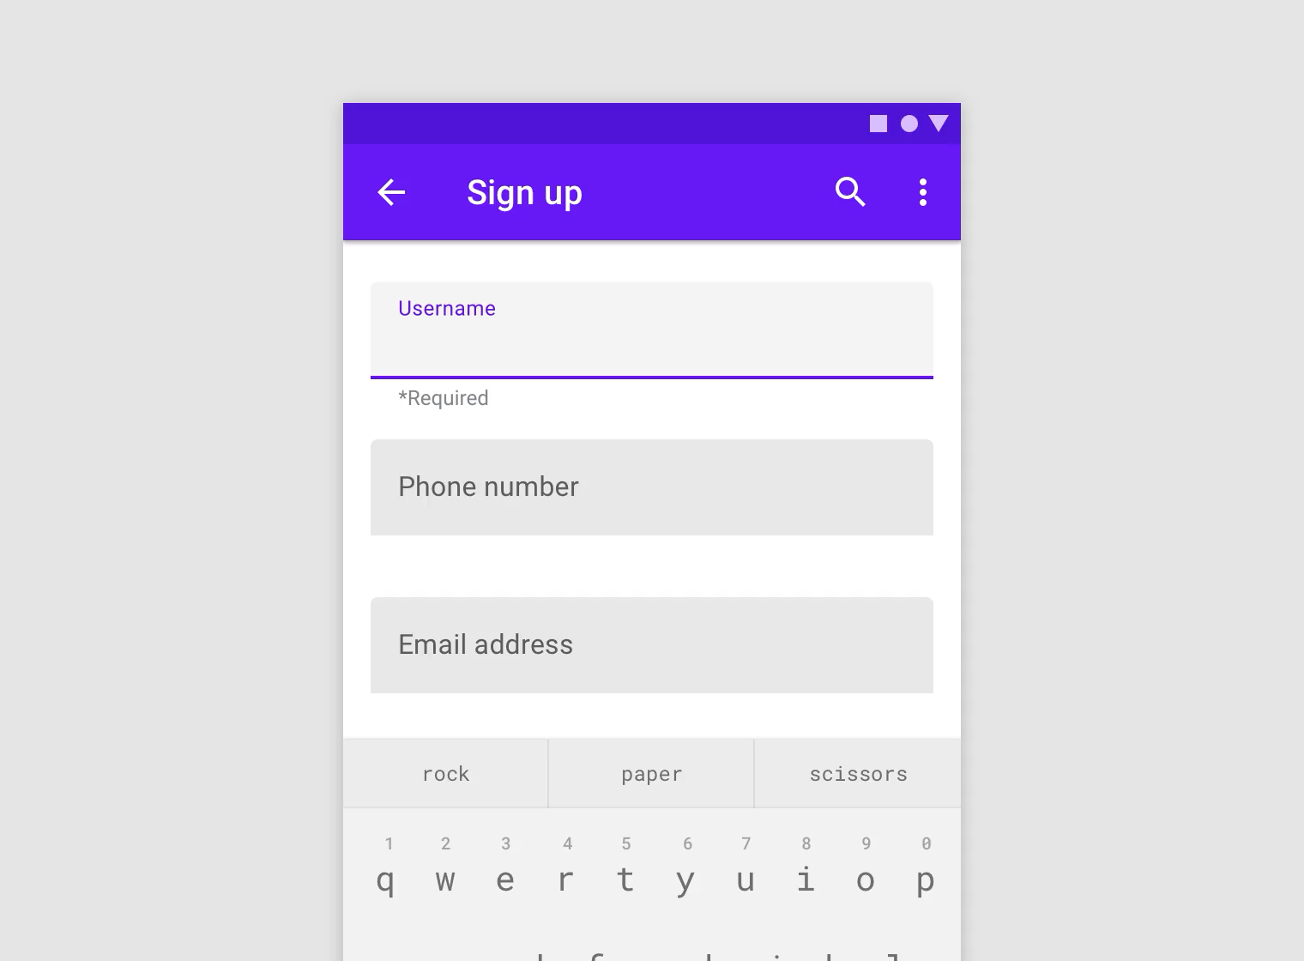
MATERIAL DESIGN, 2020. Material Design [viewed 15 November 2020]. Available from: https://material.io/components/text-fields

Slide 16
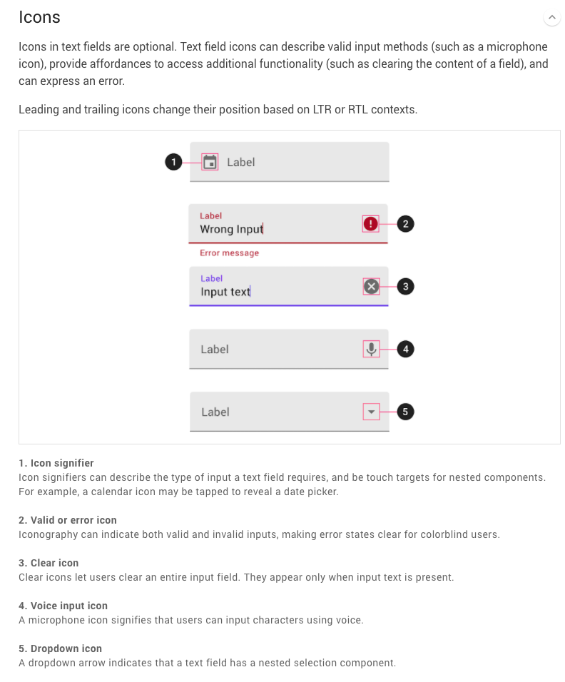
MATERIAL DESIGN, 2020. Material Design [viewed 15 November 2020]. Available from: https://material.io/components/text-fields

Slide 17
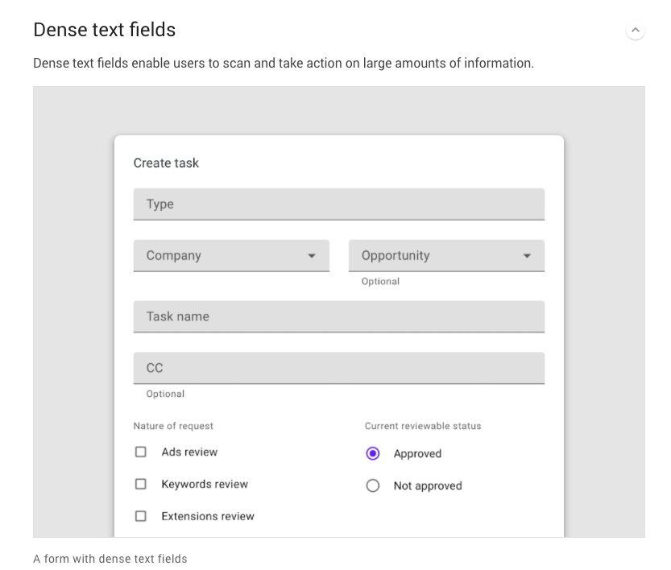
MATERIAL DESIGN, 2020. Material Design [viewed 15 November 2020]. Available from: https://material.io/components/text-fields

Slide 18
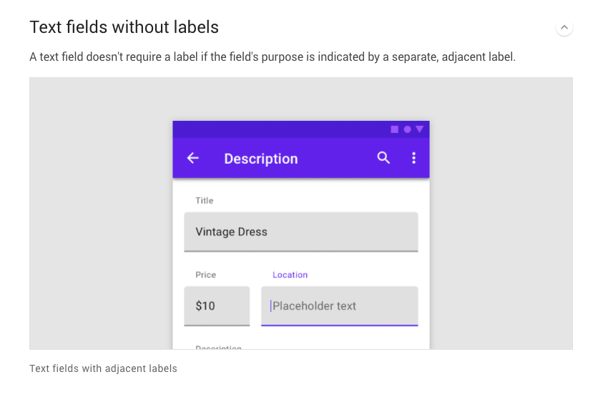
MATERIAL DESIGN, 2020. Material Design [viewed 15 November 2020]. Available from: https://material.io/components/text-fields

Slide 19
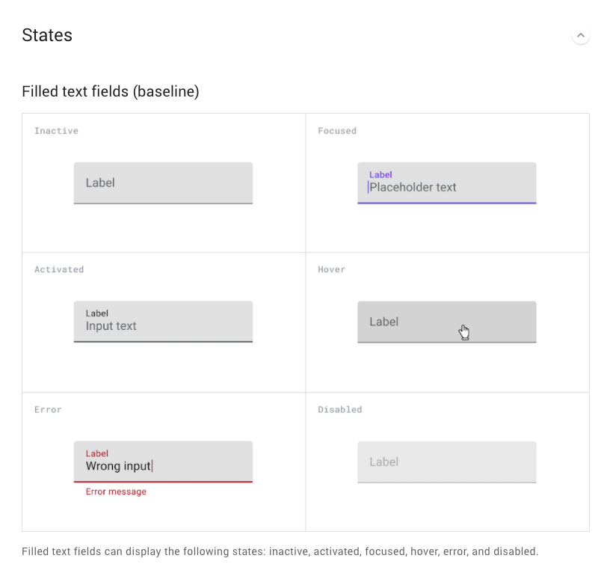
MATERIAL DESIGN, 2020. Material Design [viewed 15 November 2020]. Available from: https://material.io/components/text-fields

Slide 20
MATERIAL DESIGN, 2020. Material Design [viewed 15 November 2020]. Available from: https://material.io/components/text-fields

Slide 21
MATERIAL DESIGN, 2020. Material Design [viewed 15 November 2020]. Available from: https://material.io/components/text-fields

Slide 22
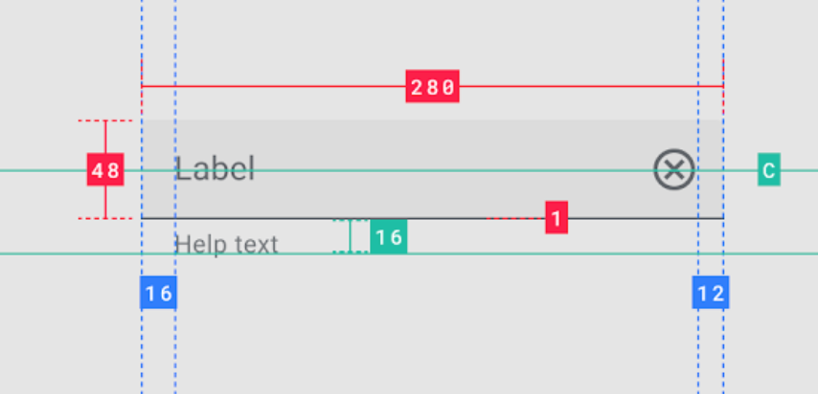
MATERIAL DESIGN, 2020. Material Design [viewed 15 November 2020]. Available from: https://material.io/components/text-fields

Slide 23
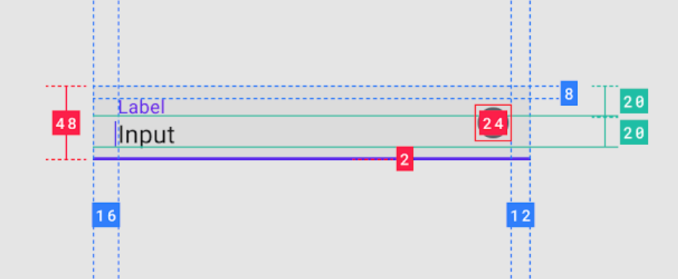
MATERIAL DESIGN, 2020. Material Design [viewed 15 November 2020]. Available from: https://material.io/components/text-fields

Slide 24
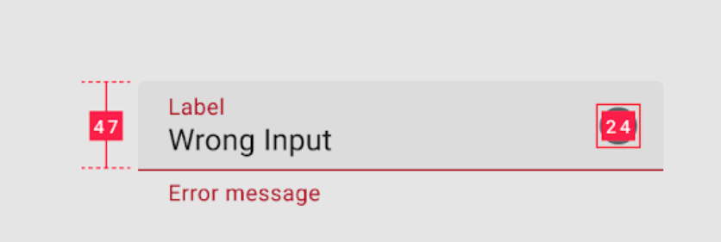
MATERIAL DESIGN, 2020. Material Design [viewed 15 November 2020]. Available from: https://material.io/components/text-fields

Slide 25
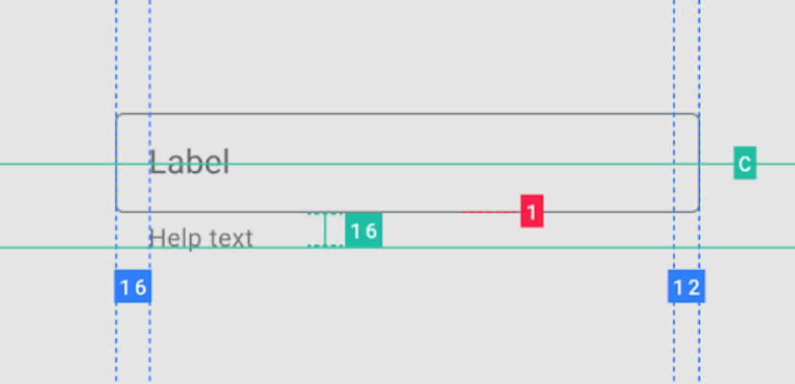
MATERIAL DESIGN, 2020. Material Design [viewed 15 November 2020]. Available from: https://material.io/components/text-fields

Slide 26
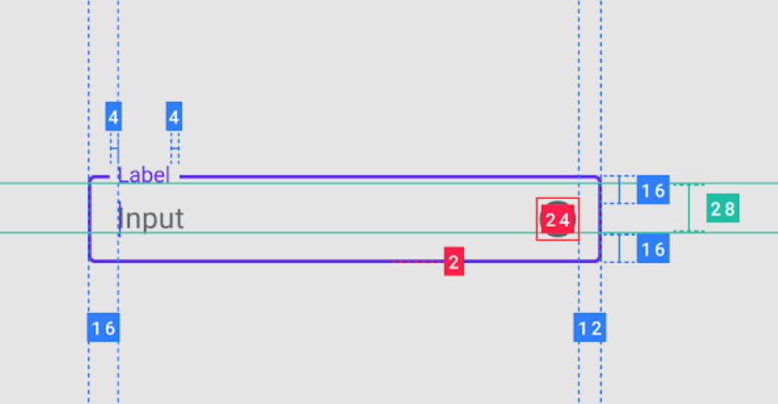
MATERIAL DESIGN, 2020. Material Design [viewed 15 November 2020]. Available from: https://material.io/components/text-fields

Slide 27
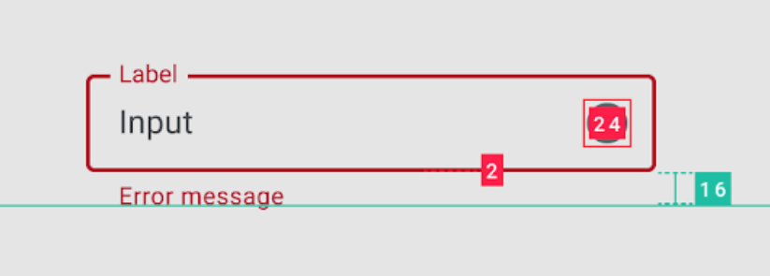
MATERIAL DESIGN, 2020. Material Design [viewed 15 November 2020]. Available from: https://material.io/components/text-fields

Slide 28
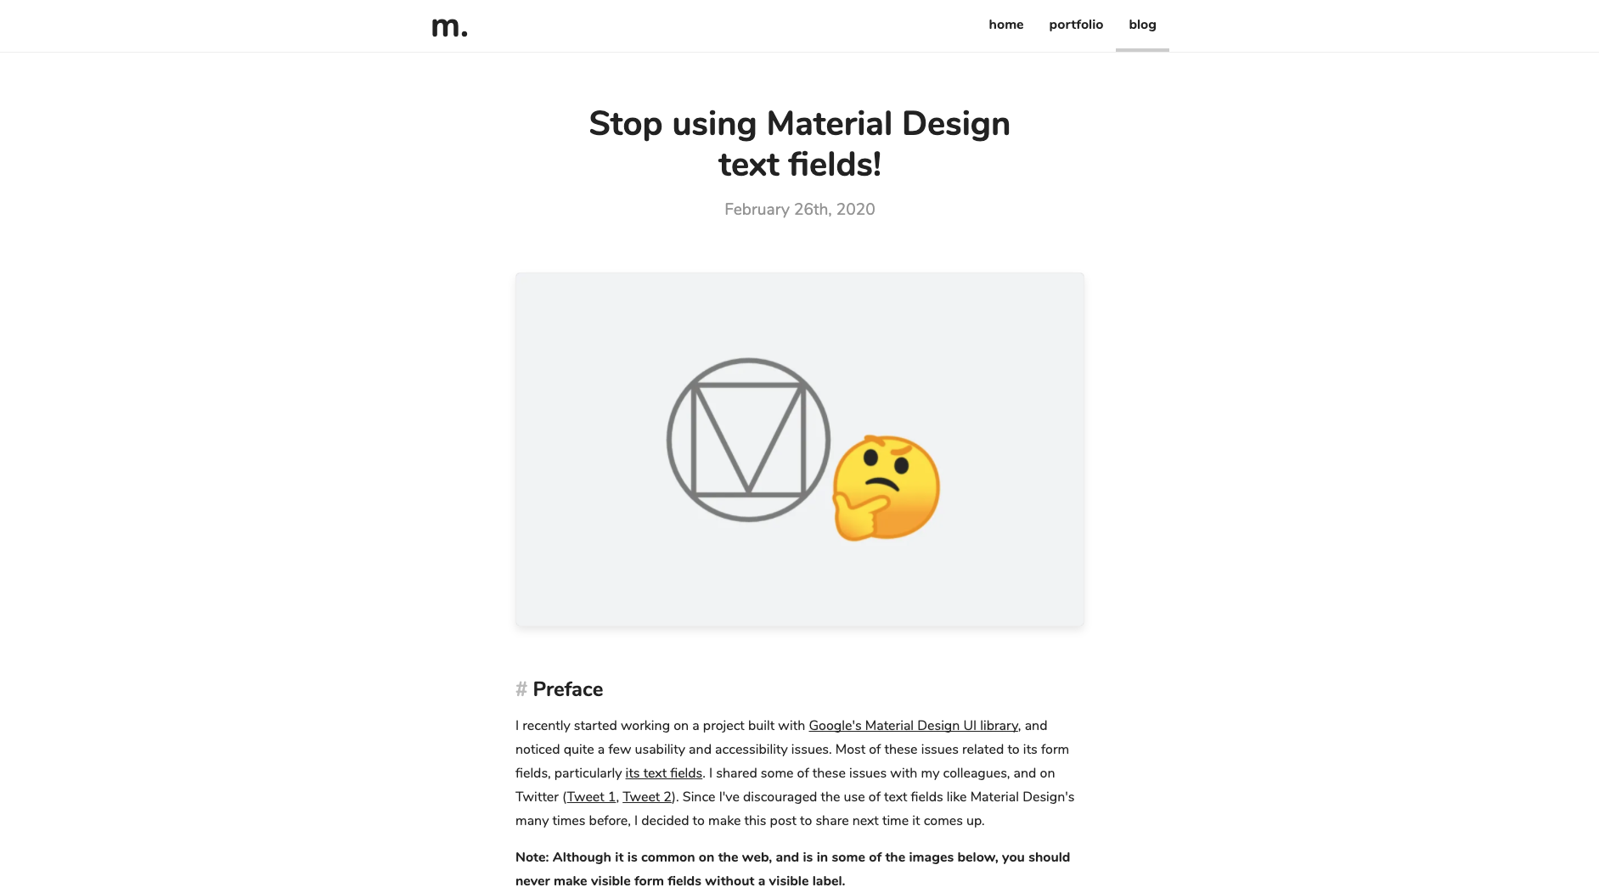
FRIEDLAND.,M, 2020. Stop using Material Design text fields! [viewed 15 November 2020]. Available from: https://www.matsuko.ca/blog/stop-using-material-design-text-fields/
‌

Slide 29
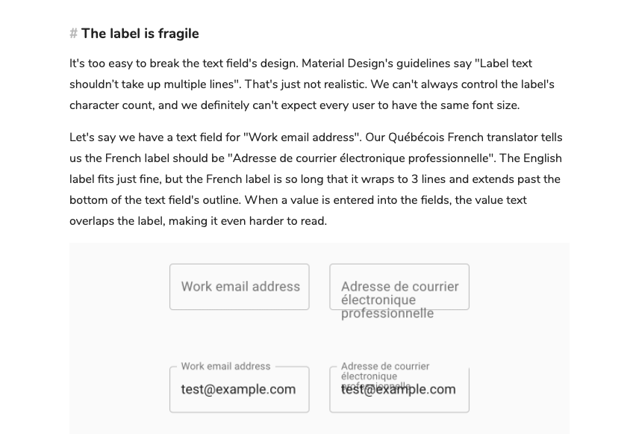
FRIEDLAND.,M, 2020. Stop using Material Design text fields! [viewed 15 November 2020]. Available from: https://www.matsuko.ca/blog/stop-using-material-design-text-fields/
‌

Slide 30
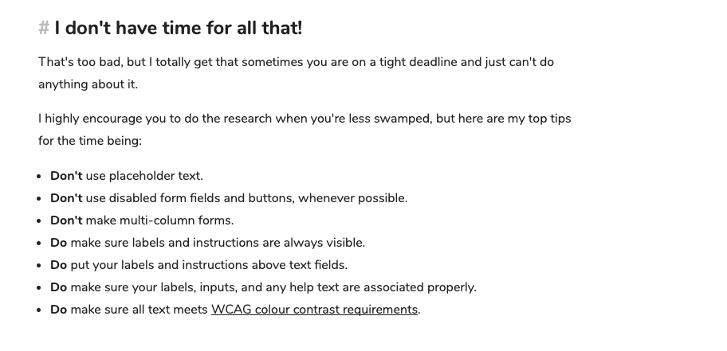
FRIEDLAND.,M, 2020. Stop using Material Design text fields! [viewed 15 November 2020]. Available from: https://www.matsuko.ca/blog/stop-using-material-design-text-fields/
‌

Slide 31
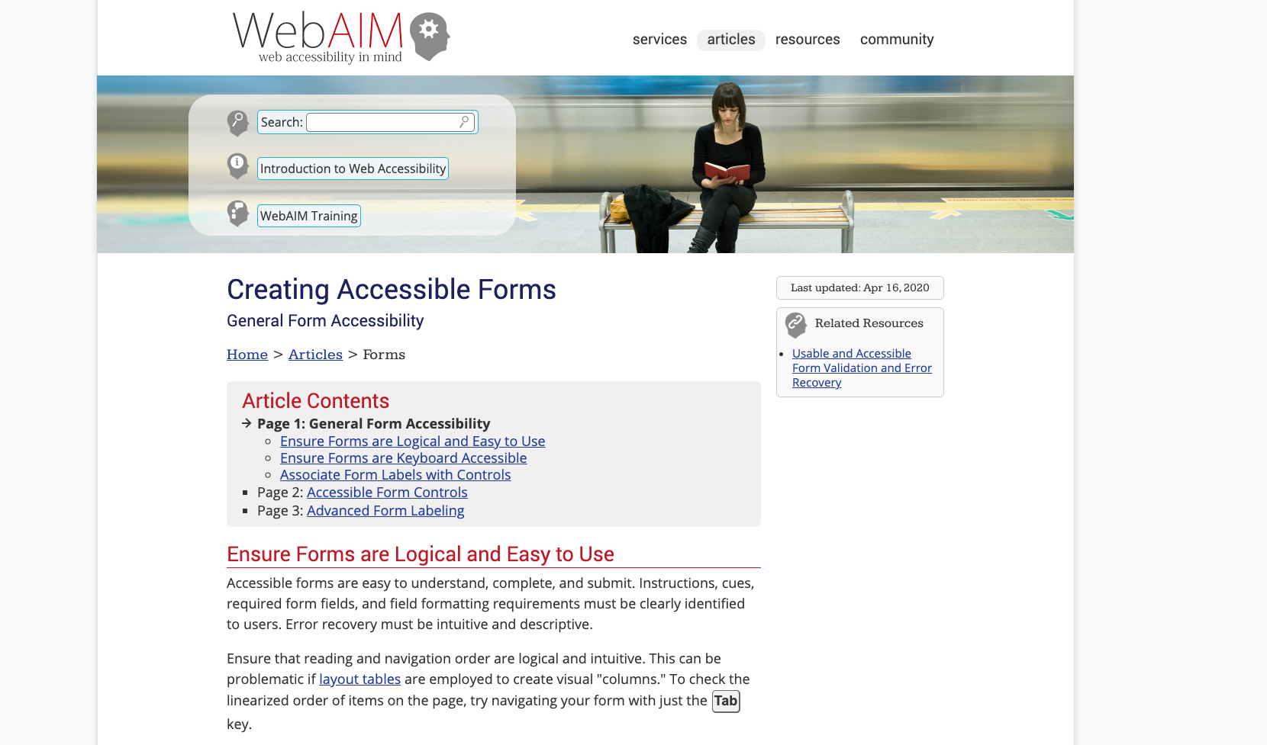
WEBAIM.ORG., 2020. WebAIM: Creating Accessible Forms - General Form Accessibility [viewed 15 November 2020]. Available from: https://webaim.org/techniques/forms/

Slide 32
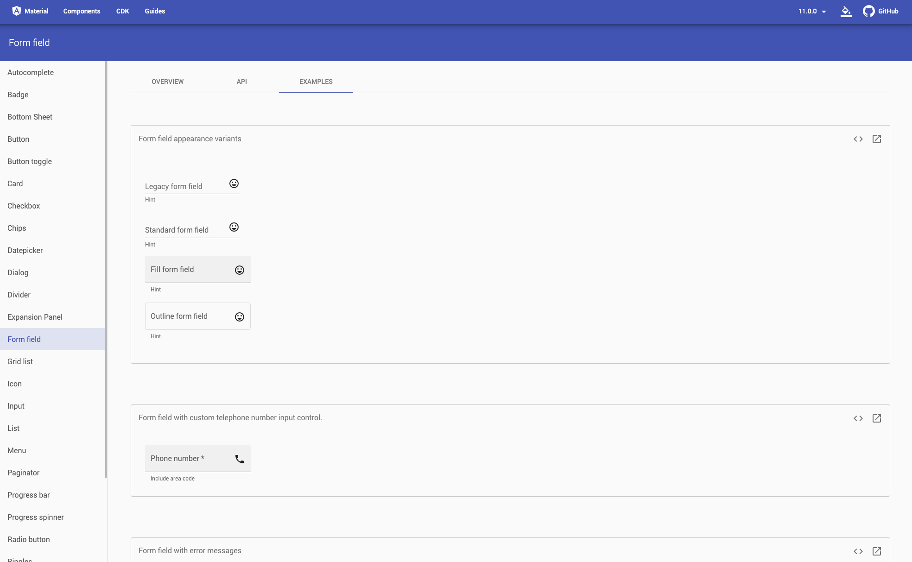
ANGULAR, 2020. Angular Material [viewed 15 November 2020]. Available from: https://material.angular.io/components/form-field/examples

Slide 33
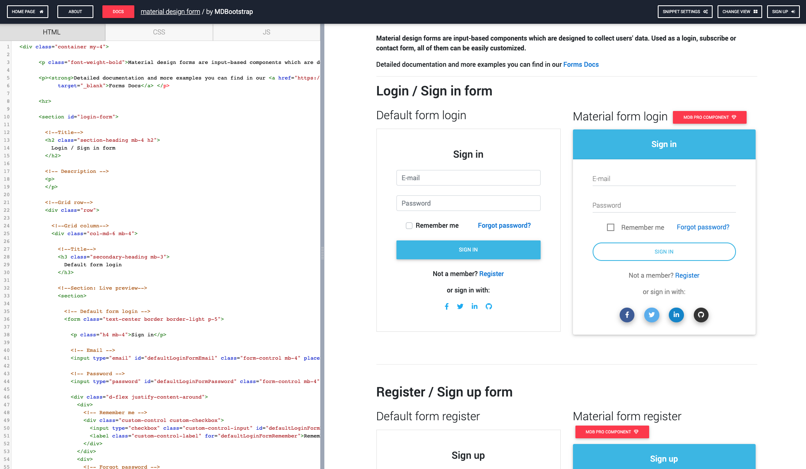
MDBOOTSTRAP.COM., 2019. Material design form - Material Design for Bootstrap [viewed 15 November 2020]. Available from: https://mdbootstrap.com/snippets/jquery/mdbootstrap/944378

